Slide 1
1. Berilgan datasetdan faqat Germanyga tegishli va score 200 dan katta yoki teng bolganlarini ajratib oling

Slide 2
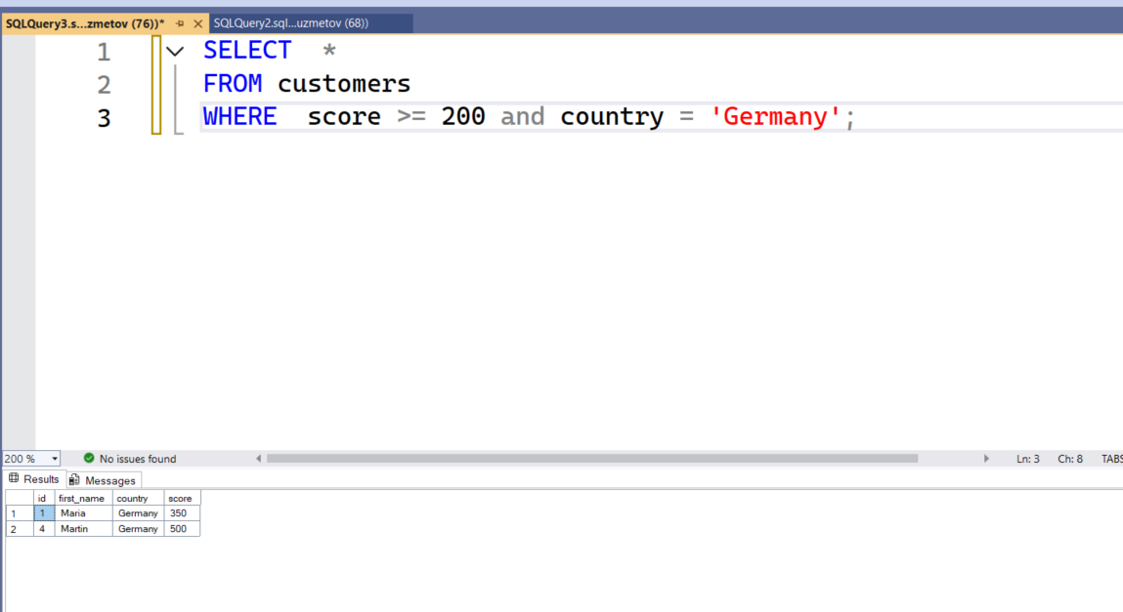

Slide 3
2. Berilgan datasetdan katta scoredan boshlab kichik score boylab tartiblang

Slide 4
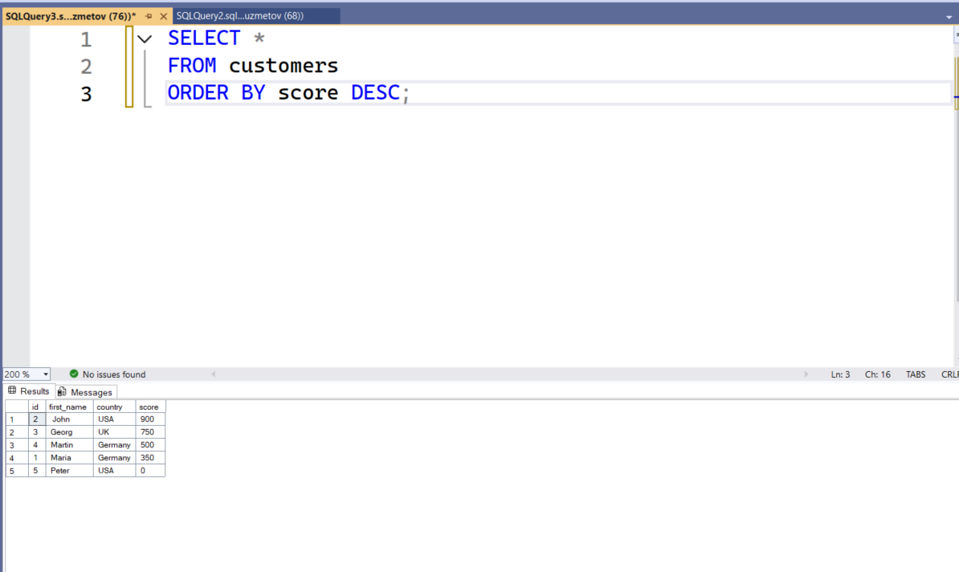

Slide 5
3. Berilgan datasetdagi scoreni mamlakatlar boyicha duplicatedlarini drop qiling

Slide 6
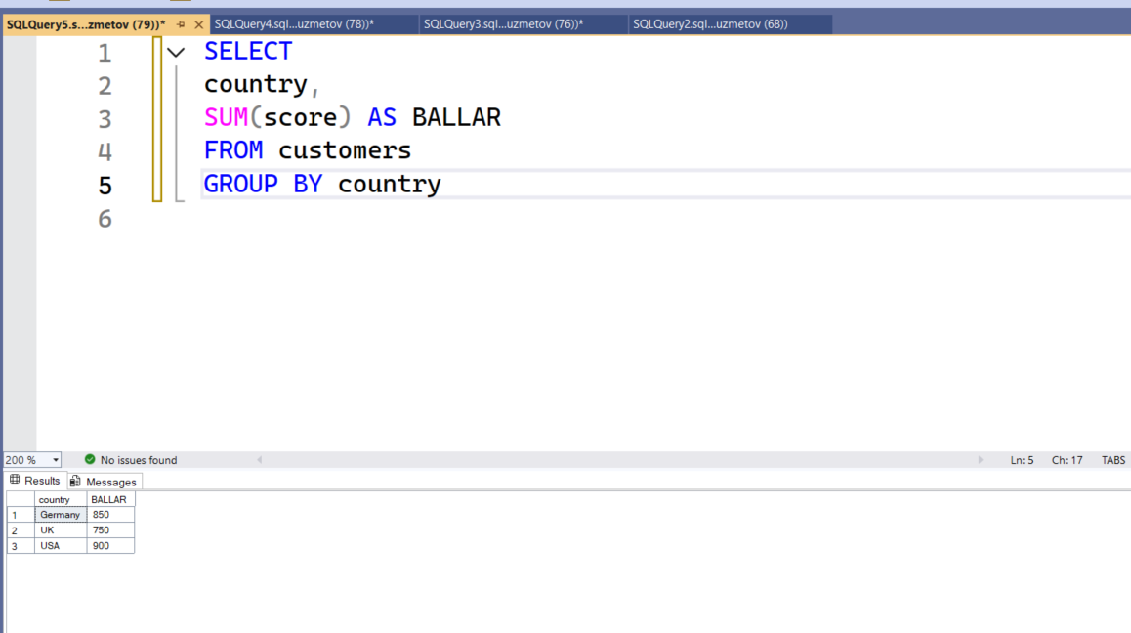

Slide 7
4. Berilgan datasetlarda score boyicha kattadan kichik tomonga yo’naltiring va faqat ism va scoreni qoldiring

Slide 8
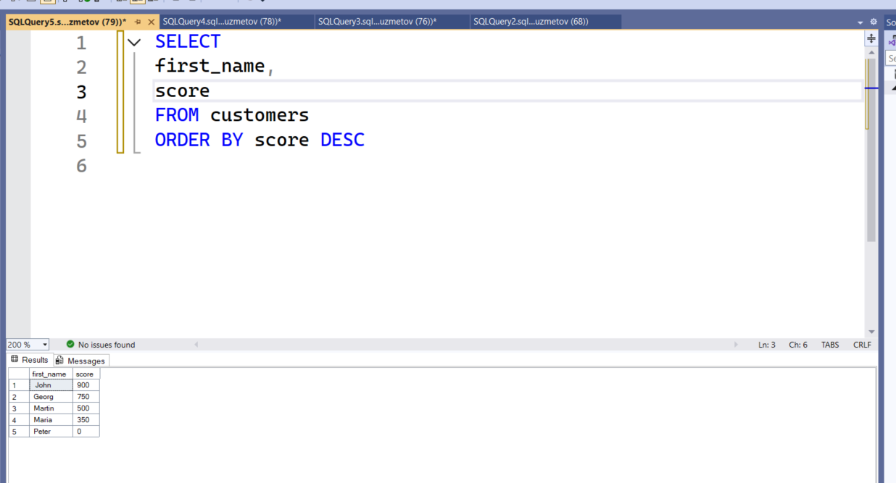

Slide 9
ML

Slide 10
1. Clusteringga loyiha qiling

Slide 11
https://github.com/rrrasulbekruzmetov/3_Oy_Vazifalar/blob/main/6-Dars/ML_Clustering.ipynb

Slide 12
2. Anomaly detectionga loyiha qiling

Slide 13
https://github.com/rrrasulbekruzmetov/3_Oy_Vazifalar/blob/main/6-Dars/ML_Anomaly_Detection.ipynb

